Slide 1
Virtual healthcare bridging patient and doctor
Bindusree.P
Bhuma venkata Siva reddy
N Hasika Seethu
S.Vishnu vardhan

Slide 2
Abstract
The medical website is a digital tool designed to provide healthcare services to individuals. This website is designed to be user-friendly. It offers a range of features including appointment booking and access to reliable health information. With the increasing demand for remote healthcare services, the medical website aims to bridge the gap between patients and healthcare providers, making healthcare more convenient, accessible, and affordable for everyone..

Slide 3

Problem statement
The healthcare industry faces numerous challenges in providing accessible and affordable healthcare services to all individuals. One of the major problems is the lack of access to healthcare services, particularly for people living in remote areas or those with mobility issues.

Slide 4


Existing solutions
Practo: Practo is an online platform that connects patients with doctors, clinics, and hospitals. It offers a range of services including online consultations, prescription ordering, appointment booking, and health record storage.
Zocdoc: Zocdoc is a healthcare appointment booking platform that allows patients to find and book appointments with doctors in their area. It also offers features like patient reviews, doctor profiles, and wait-time estimates.

Slide 5
Our solution
The medical website aims to solve these problems by providing a digital platform that connects patients with healthcare providers and offers a range of features to improve healthcare accessibility and management.

Slide 6
SWOT analysis
Strength : our model classifies diseases according to its severity and gives precautions in advance before consulting the doctor
Weakness : our website couldn’t predict all the diseases because of its data insufficiency
Opportunity : if we could develop we can sell it to one particular company which sells medicines and recommend it’s products i.e medicines made by that company to users which is highly profitable
Threat : hackers

Slide 7
SWOT analysis
Strength : our model classifies diseases according to its severity and gives precautions in advance before consulting the doctor Weakness : our app couldn’t predict all the diseases coz of its data insufficiency Oppurtunity : if we could develop we can sell it to one particular company which sells medicines and recommend it’s products i.e medicines made by that company to users which is highly profitable Threat : hackers

Slide 8

Customers and consumers
Hospitals and Clinics Healthcare Providers Patients

Slide 9

Developed on
Python.
Data set and analysis from Kaggle.com
Editor: VSCode.
Libraries: Pandas, Numpy, sklearn, streamlit.

Slide 10
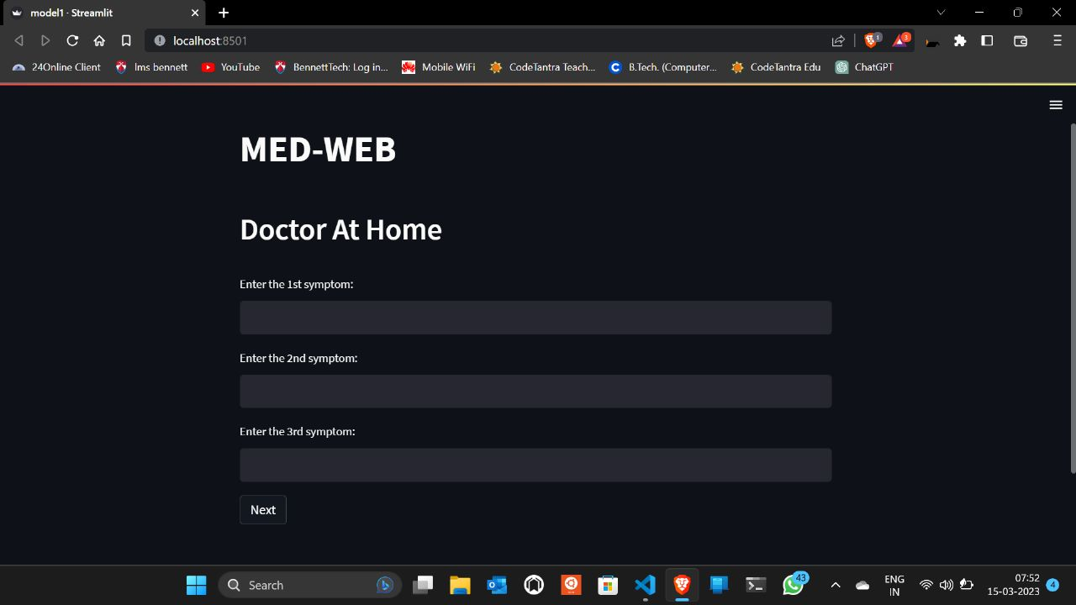

Slide 11
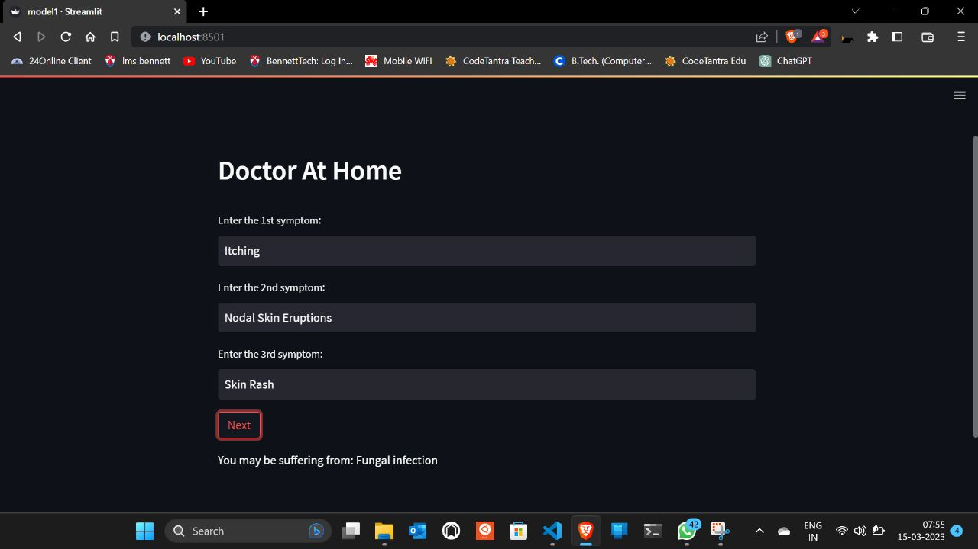

Slide 12

We are happy to hear your feed back, as well as we would like to comeback stronger.

